Slide 1
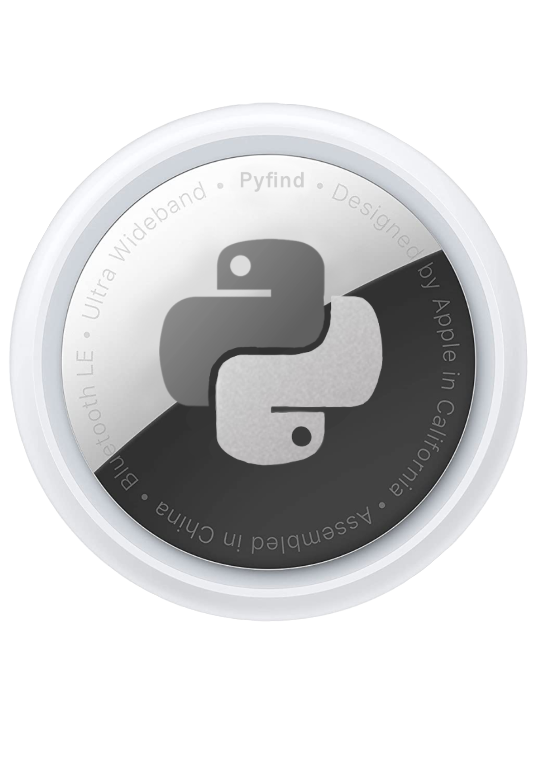
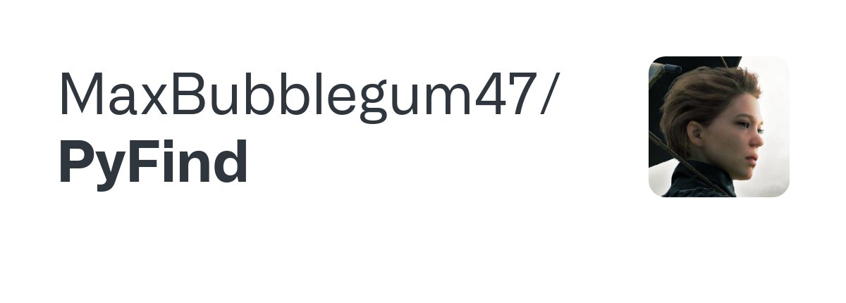
Lorenzo Stigliano, Crittografia Applicata 2023

Slide 2
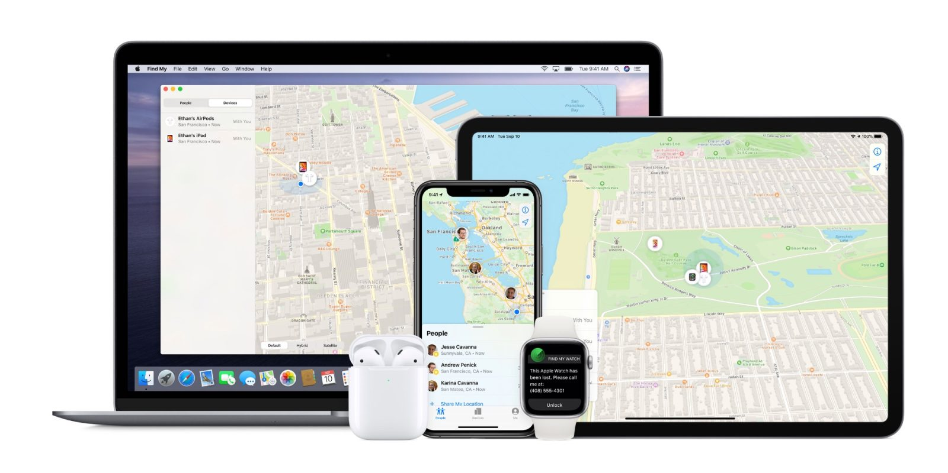
One App to find it all.

Slide 3
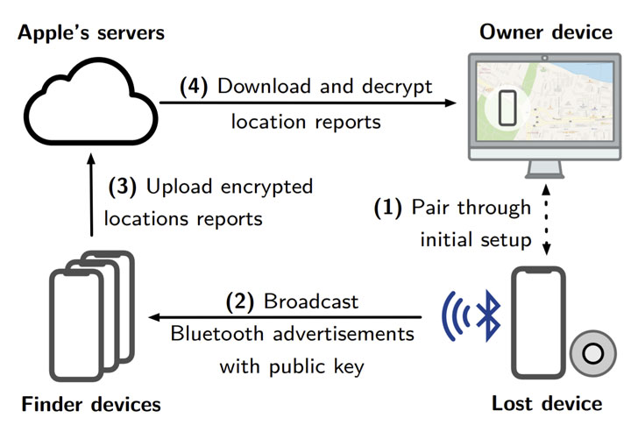
How does it work?

Slide 4
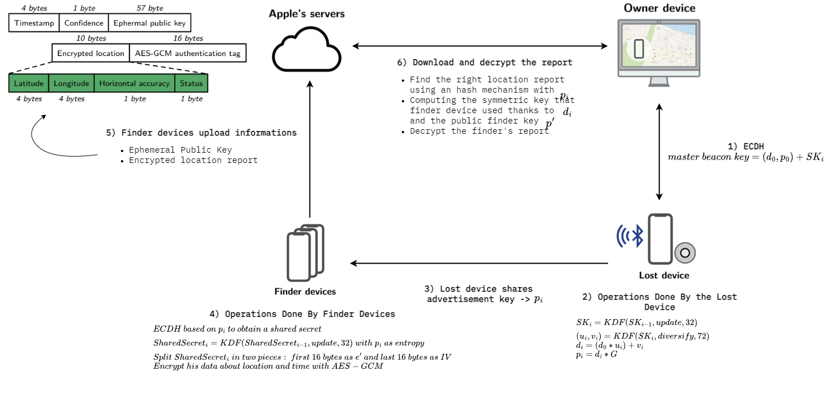
How does it work? [Detailed]

Slide 5
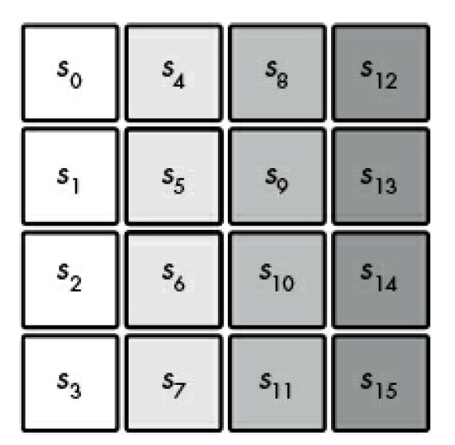
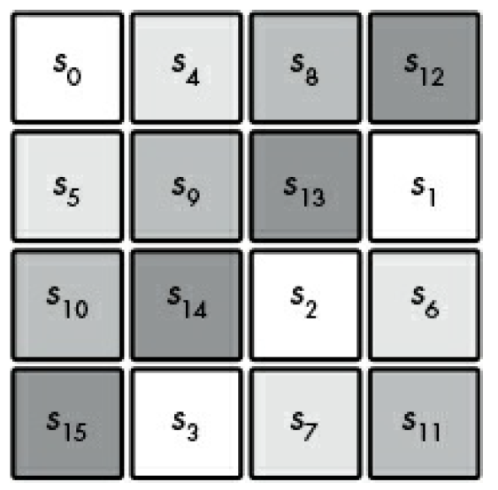
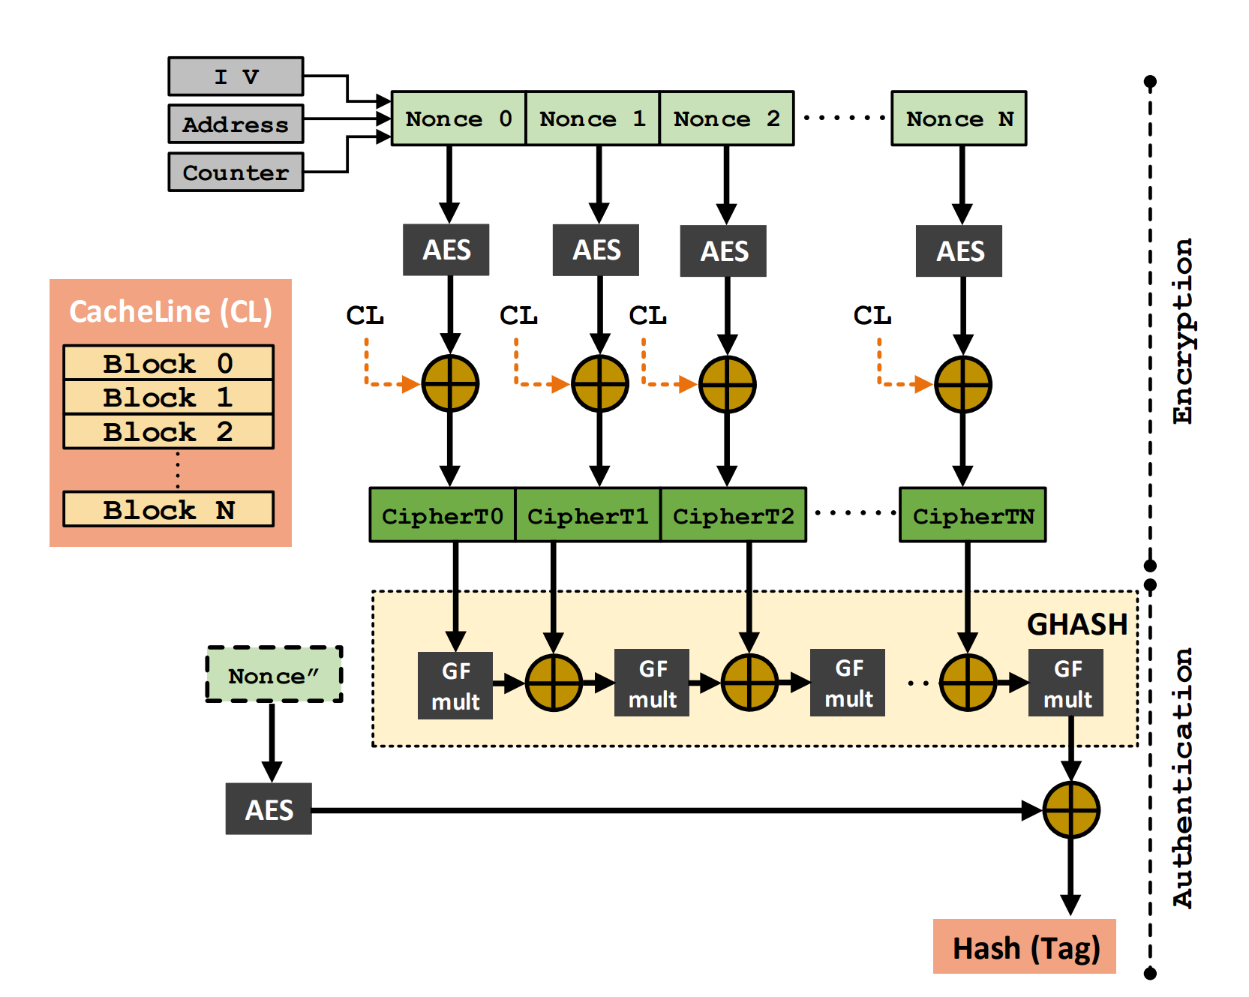
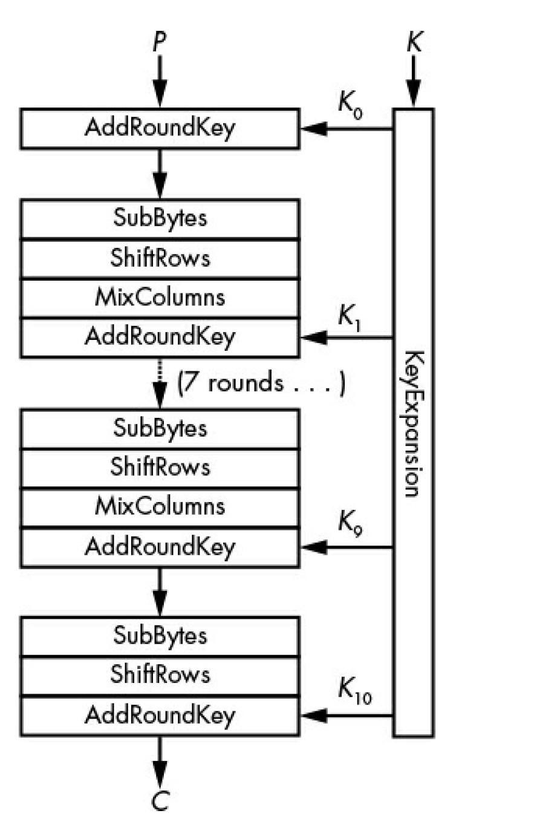
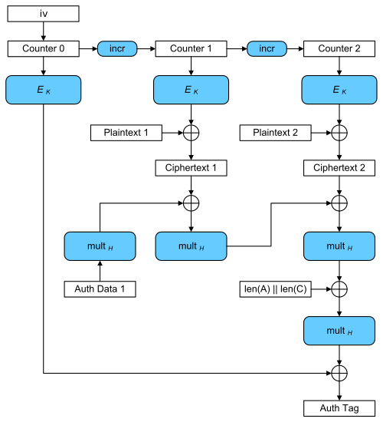
AES-GCM
Example of ShiftRows operation
GMC Internals Scheme

Slide 6
Where Things Break
…

Slide 7
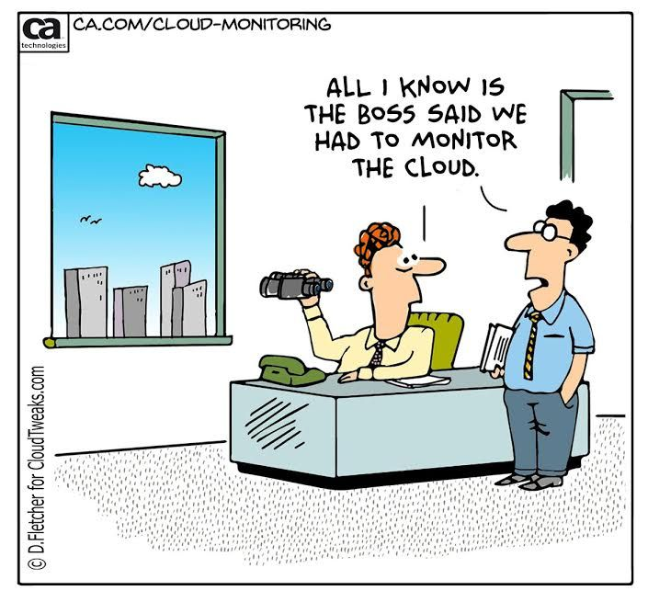
There is something missing…
How do we know the EXACT advertisement key produced by a missing device???

Slide 8

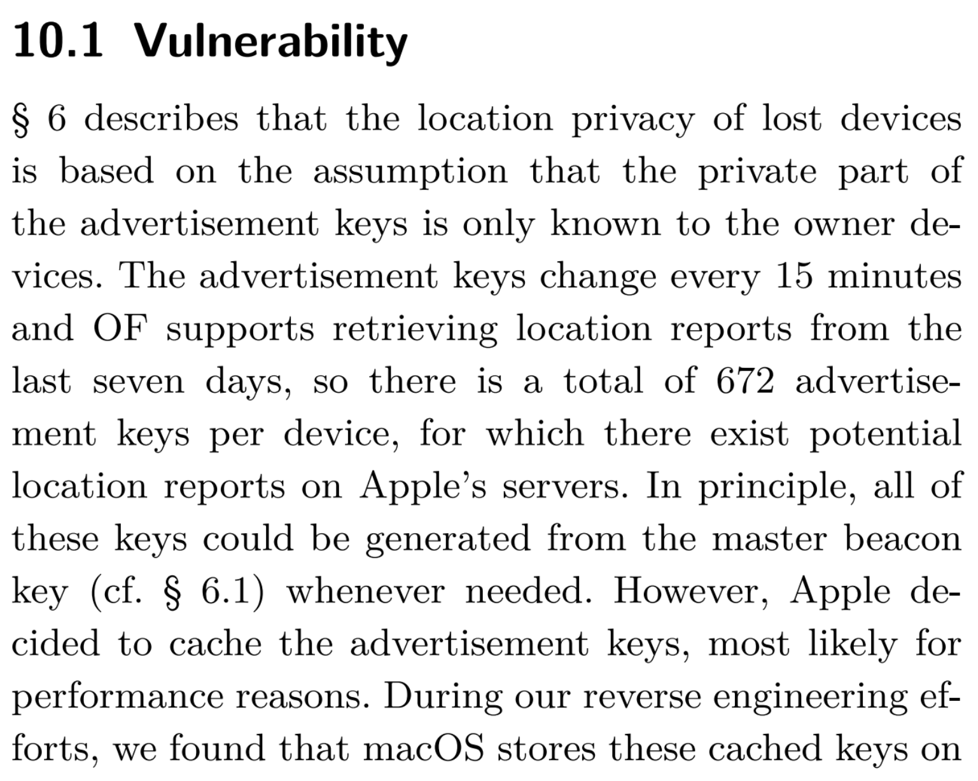
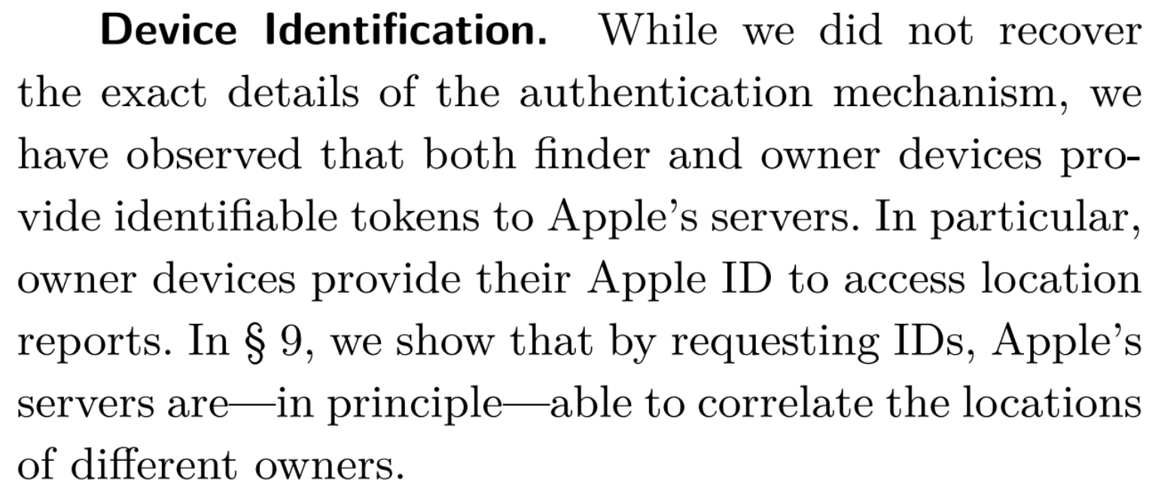
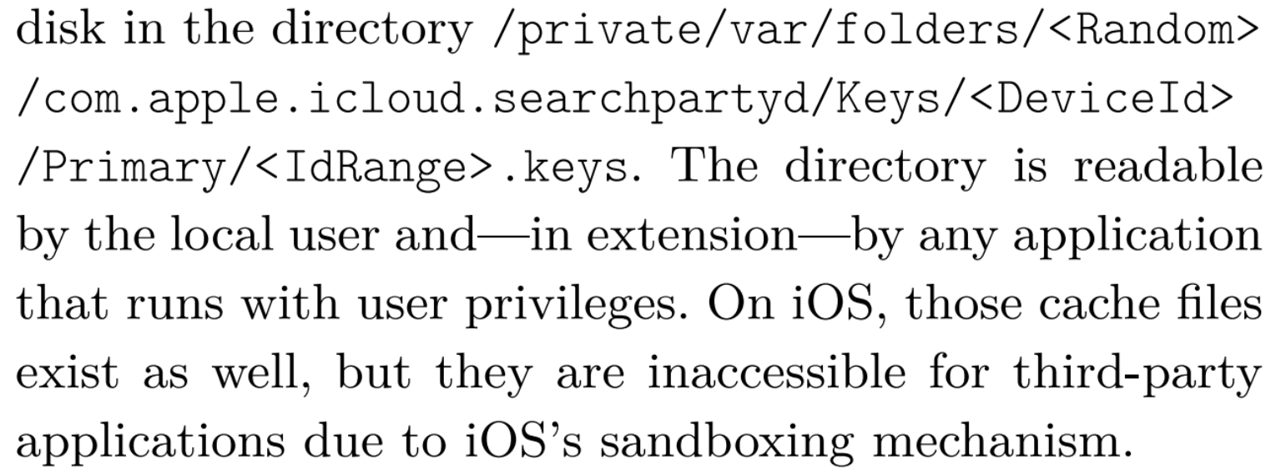









Slide 9
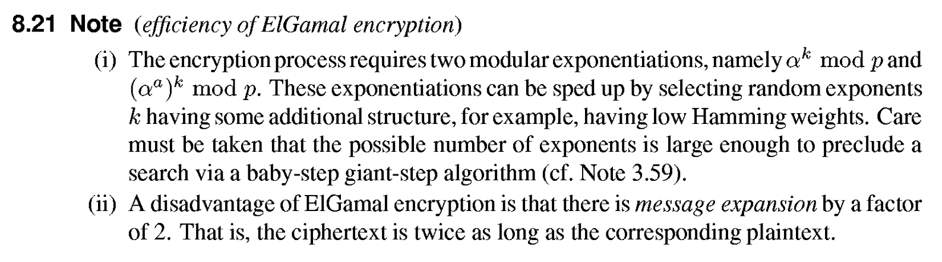
Alternatives to ECDH?
Why do we not use Elgamal??? OVERHEAD

Slide 10
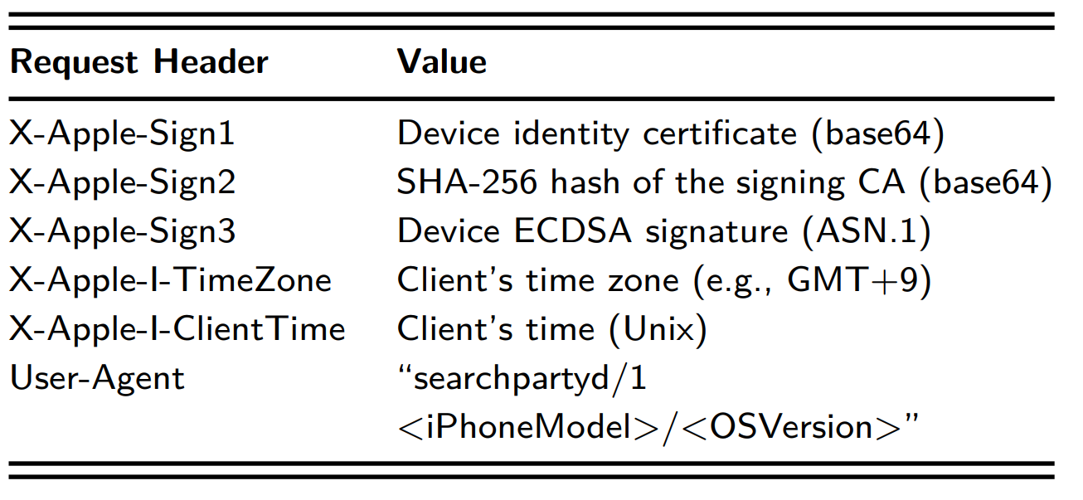
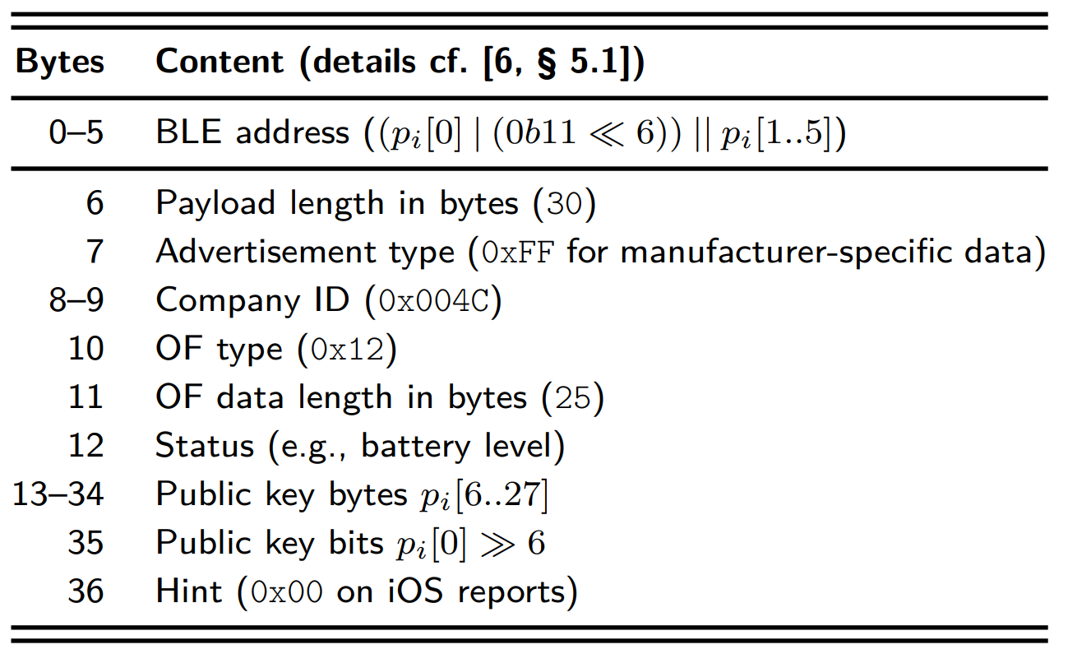
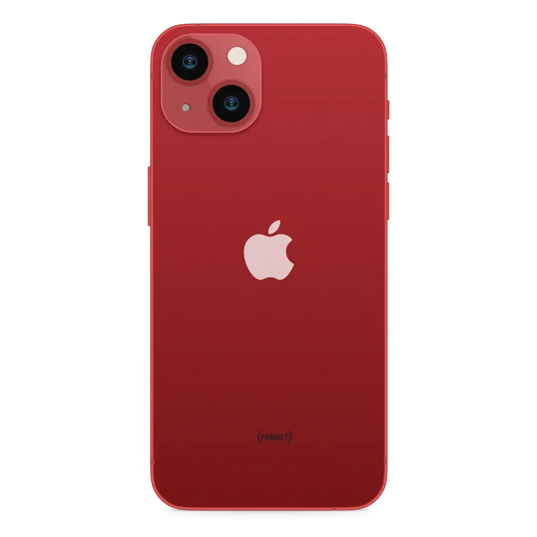
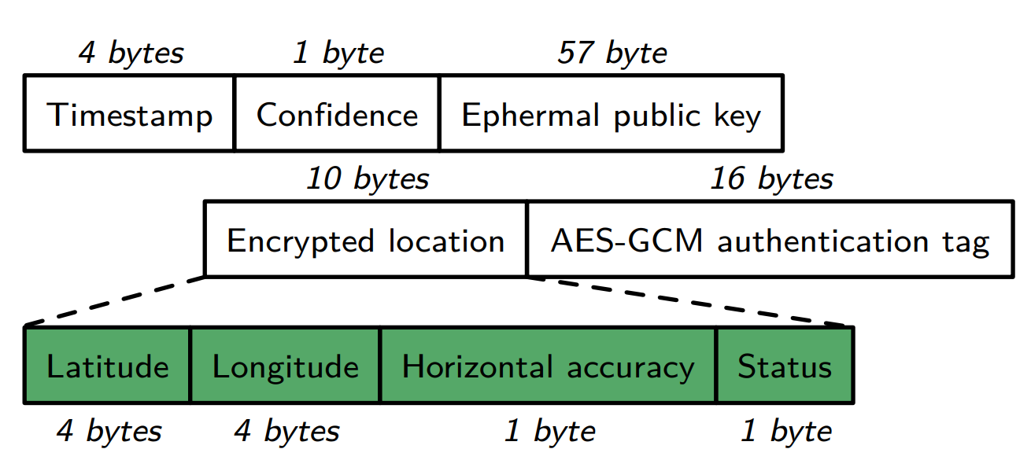
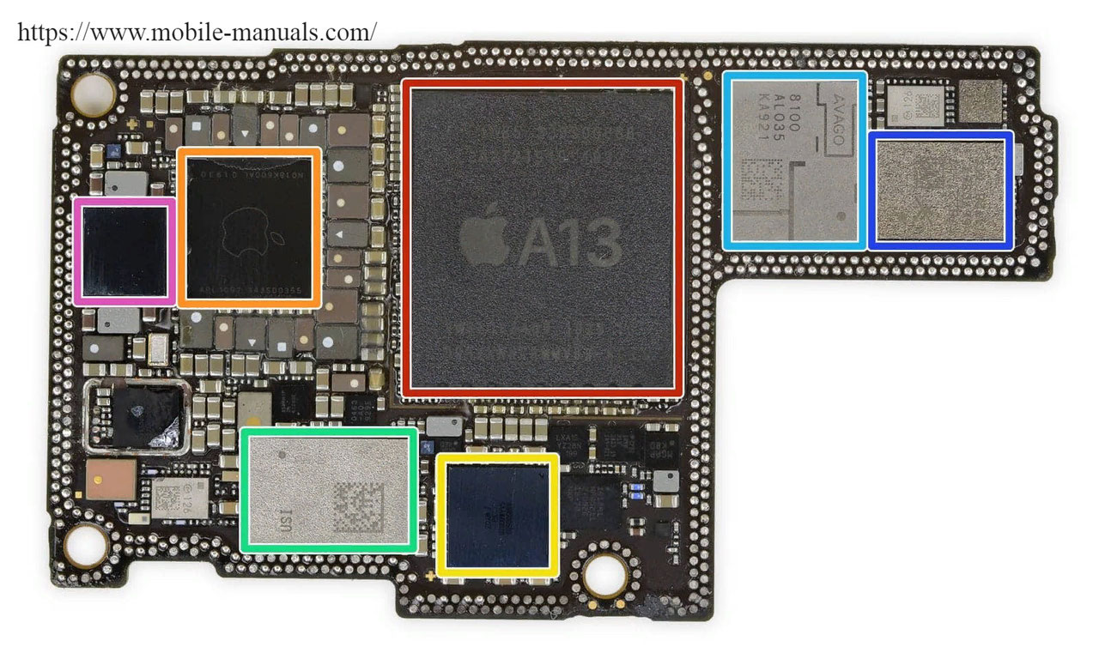


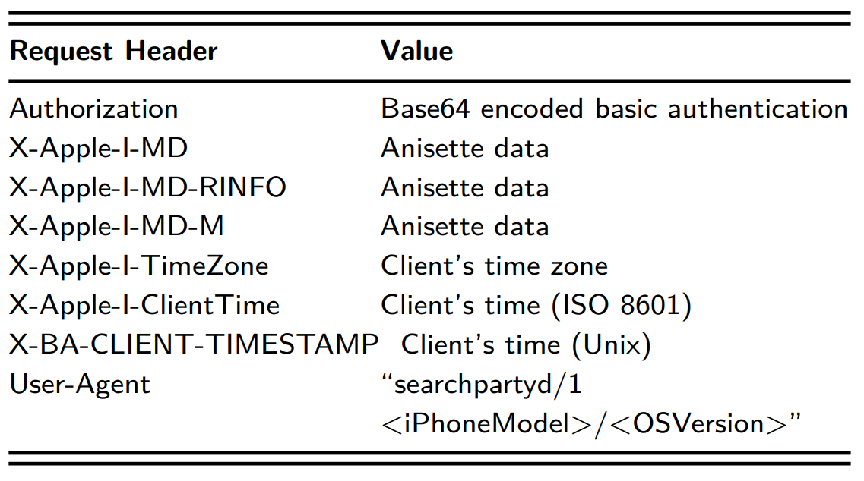
Technical Implementation
Lost iPhone
Finder’s iPhone
iCloud
Owner’s Laptop

Slide 11
Demo Time!
Language: Python
Libraries: tinyec, cryptodome, cryptography, secrets
Docs:
Who Can Find My Devices? Security and Privacy of Apple’s Crowd-Sourced Bluetooth Location Tracking System (Alexander Heinrich, Milan Stute, Tim Kornhuber and Matthias Hollick)
SERIOUS CRYPTOGRAPHY A Practical Introduction to Modern Encryption (Jean-Philippe Aumasson)
(Discrete Mathematics and Its Applications) Alfred Menezes, Paul van Oorschot, Scott Vanstone - Handbook of applied cryptography
Practical Cryptography for Developers (Svetlin Nakov)
SMARTS: Secure Memory Assurance of RISC-V Trusted SoC (Ming Ming Wong, Jawad Haj-Yahya, Anupam Chattopadhyay, Nanyang Technological University (NTU) Singapore anupam@ntu.edu.s)

Slide 12
Questions?

